Slide 1
Training Presentation
MD5 Series High Performance Digital Vinyl
The contents of this presentation are confidential. Please do not duplicate or distribute without written permission from Metamark (UK) Limited.

Slide 2
MD5 Series High Performance Digital Vinyl Start using Metamark MD5 in your printer and you could be forgiven for thinking you’d had a hardware upgrade. Simply put, no other polymeric calendered material can give you the amazing quality you’ll get with MD5.

Slide 3
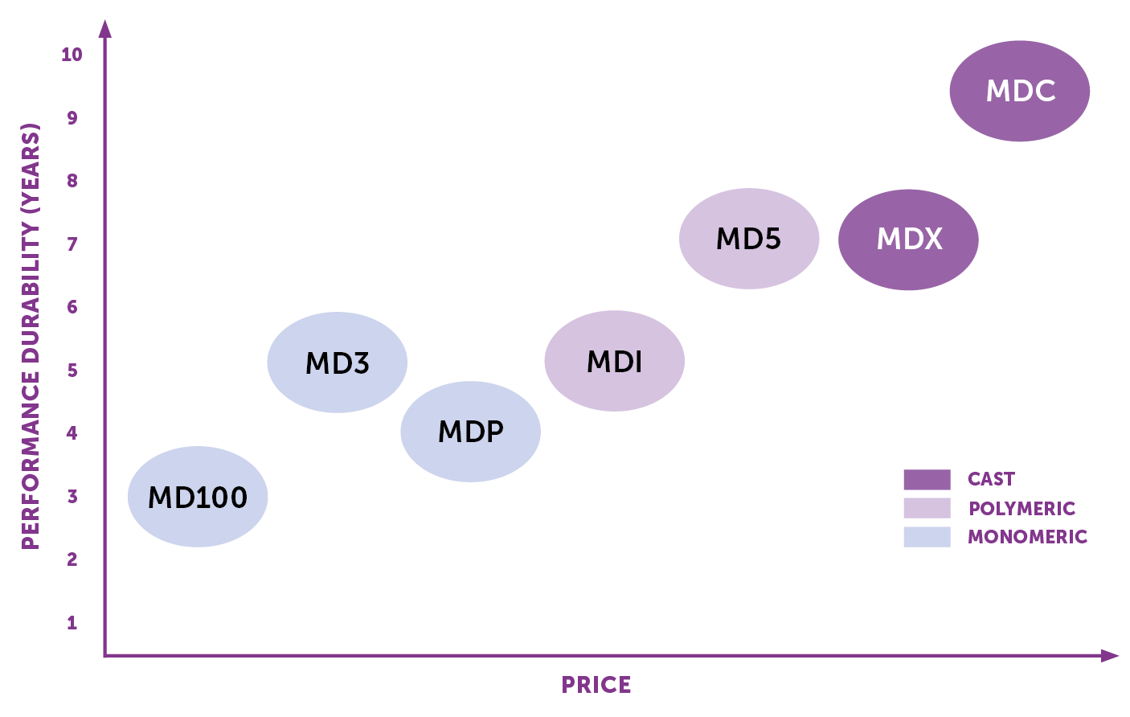
Metamark
Digital Range

Slide 4
MD5 Series
Features and Benefits
MD Class print quality Part of Metamark’s MD-Class digital media portfolio. MD-Class materials are engineered to deliver benchmark-setting technical performance and out-of-the-box compatibility with Solvent, Eco-Solvent, Latex and UV inks. |  | Choice of adhesive systems Supplied with the option of Metamark’s Apex® permanent adhesive, MetaScape® air release system, MetaGlide® Micro channel air release system or MetaGrab® Ultra Tack adhesive.
Manufacturer Specified Media Metamark MD5 is specified by leading printer manufacturers as a quality and technical benchmark reference product for printer testing and development, for its best in class print capability. |  | The print professional’s media MD5 is the professionals’ go-to digital media product. It covers, a wide range of demanding applications, delivering benchmark setting quality and reliability.
Premium Quality Film Metamark MD5 is a premium grade polymeric calendared product, UK manufactured and engineered with the highest quality raw materials. |  | MetaSure Warranty – 7 years Performance assured by the MetaSure warranty for up to 7 years. For full details of the MetaSure warranty, and warranty for international regions, visit www.metamark.co.uk/support.

Slide 5
MD5 Series
Product Positioning / Competitor Equivalent
Competitor
Hexis V200
Metamark MD5
Avery MPI2000 / 2800
IP2553
Grafityp S20P
Orajet® 3551
Mactac 5929P
Durability
8 Years
7 Years
7 Years
7 Years
7 Years
7 Years
7 Years

Slide 6
MD5 Series
Technical Specification
Specification
Compliance
70 Micron Polymeric PVC Facefilm
Adhesives available:
Apex® Solvent-Based
MetaScape® Solvent-Based
MetaGlide® Solvent-Based
MetaGrab® Solvent-Based
PE coated Layflat Liner
2 Year Shelf-life
7 years Durability
Fire tested to EN 13501-1:2007 - Class B.
Fire tested to BS476 - Class 0 (applied to glass)
Reach Compliant
RoHS Compliant
Durability: Vertical exposure under northern European conditions. For other Regions please see our durability guide available @ www.metamark.co.uk

Slide 7
MD5 Series
Product Line Up
SKU |  | Finish |  |  |  | Adhesive System
 | Description | Gloss | Satin | Matt | SandTex | Clear | Clear UV | Grey | Permanent | Apex | High-Tack | MetaScape | MetaGlide | MetaGrab®
MD5 | High Performance Calendered Digital Vinyl | ✓ | ✓ | ✓ |  | ✓ |  |  | ✓ | ✓
MD5-A | MetaScape® High Performance Vinyl | ✓ |  |  |  | ✓ |  |  | ✓ |  |  | ✓
MD5-B | High Performance Blockout Vinyl | ✓ |  |  |  |  |  | ✓ | ✓ | ✓
MD5-AB | MetaScape® Blockout High Performance Vinyl | ✓ |  |  |  |  |  | ✓ | ✓ |  |  | ✓
MD5-H | High-Tack High Performance Vinyl | ✓ |  |  |  | ✓ |  |  | ✓ |  | ✓
MD5-HB | High-Tack Blockout High Performance Vinyl | ✓ |  |  |  |  |  | ✓ | ✓ |  | ✓
MD5-AH | High-Tack MetaScape® High Performance Vinyl | ✓ |  |  |  | ✓ |  |  | ✓ |  | ✓ | ✓
MD5-UB | MetaGrab® Ultra-Tack High Performance Vinyl | ✓ |  | ✓ |  |  |  | ✓ | ✓ |  |  |  |  | ✓
MD5-GB | MetaGlide® Blockout High Performance Vinyl | ✓ |  |  |  |  |  | ✓ | ✓ |  |  |  | ✓
 | Matched Laminate
MG-705 | Premium Calendered Overlaminate | ✓ |  |  |  | ✓ |  |  | ✓
MG-702 | Premium Calendered Overlaminate |  |  | ✓ |  | ✓ |  |  | ✓
MG-703 | Premium Calendered Overlaminate |  | ✓ |  |  | ✓ |  |  | ✓
MG-706 | Premium Calendered Overlaminate |  |  |  | ✓ | ✓ |  |  | ✓
MG-UV-705 | Premium Overlaminate for UV prints | ✓ |  |  |  |  | ✓ |  | ✓
MG-UV-702 | Premium Overlaminate for UV prints |  |  | ✓ |  |  | ✓ |  | ✓

Slide 8

MD5 Series
Adhesives
^{Apex® Adhesive}
The latest Apex® adhesive system delivers easy handling and application, high performance and clean removal. Available in clear, grey blockout (B) & High Tack (H).
Performance. The novel, fully cross linked, solvent based Apex formulation delivers a high ultimate bond to the substrate after initial application.
Removability. Despite the high bond to the applications substrate, films featuring our Apex formulation remove cleanly.
Satisfaction. Products featuring our Apex adhesive are freely chosen and specified world-wide in a demanding range of applications including taxi advertising, fleet marking and branding.

Slide 9

MD5 Series
Adhesives
MetaScape® Adhesive System - (A)
The MetaScape adhesive system offers ease of application by providing air with an exit route from under the graphic.
Ease. MetaScape makes for faster, trouble free application of larger graphics onto smooth, flat or slightly curved surfaces.
Speed. MetaScape adhesive system is suitable for a dry application method, resulting in a durable graphic much sooner after installation.
Bubble Free. Air may be expelled during application through the channels in the adhesive.
Best results are achieved with overlaminated graphics.

Slide 10
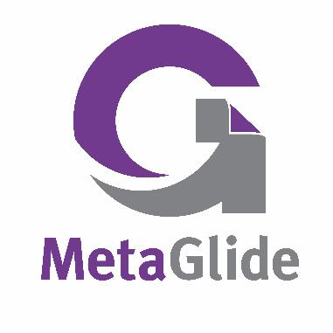
MD5 Series
Adhesives
MetaGlide®- Superior Handling Adhesive - (G)
MetaGlide® next generation air release system offers improved all round handling. Enhanced layflat performance, smoother repositioning, total adhesion confidence.
Easy Handling. With its micro structured air release liner, MetaGlide® offers improved all round handling. Smoother repositioning. Lift and reapply MetaGlide® graphics with a smooth clean peal that prevents damage to the graphic.
Advanced Layflat performance. MetaGlide® system offers exceptional layflat printability. Prints can stay stored or loosely rolled confidentially, without tunnelling or delamination.
Total confidence. Unlike comparable adhesive systems, with its high strength adhesive, MetaGlide® offers complete peace of mind, the graphic applies with complete confidence and assurance.

Slide 11

MD5 Series
Adhesives
MetaGrab®- Ultra Tack Adhesive - (UB)
MetaGrab® has been uniquely developed to offer a very high tack onto rough, textured, and difficult-to-stick-to surfaces.
Ultra Tack. Films that stick. Our highest adhesive tack available.
Applications. Including walls and floor décor onto sealed plastered, concrete, or floors. It is also suitable for textured low energy plastics.
Strength. MetaGrab® offers high internal strength and cohesivity and is a solvent-based acrylic.

Slide 12
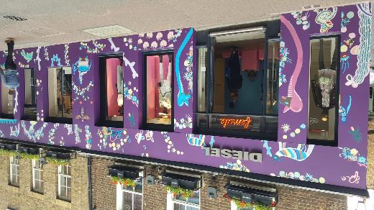
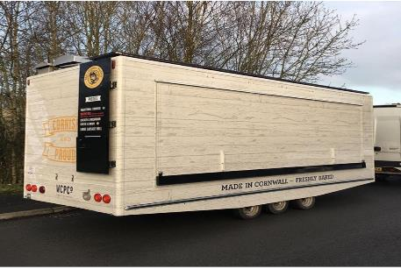
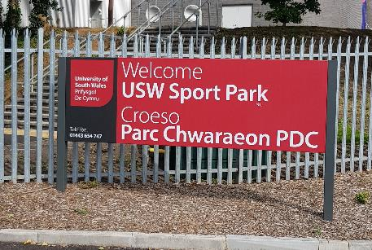
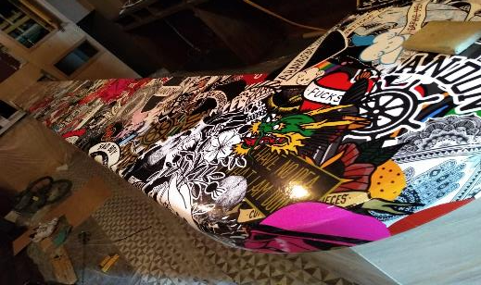
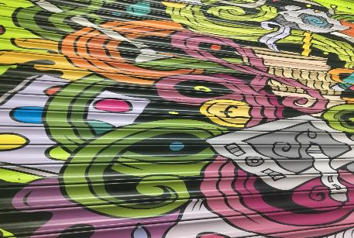
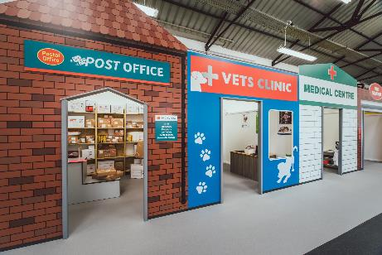
MD5 Series
Application Examples

Slide 13
Sales Tools

Slide 14
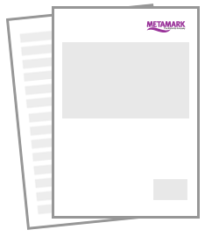
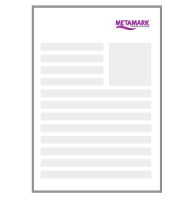
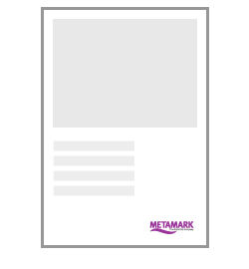
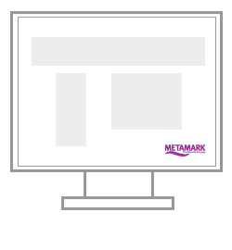
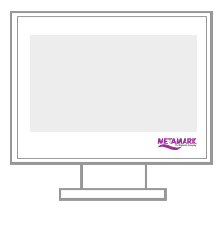
Sales Tool Kit
The following sales tools can be found on the Metamark Elite site.
For access to the site please speak with your Metamark Account Manager.
Sales Sheet
Case Study
A4 Sample Artwork
Digital Banners
Videos

Slide 15
Thank You If you require any further information about Metamark products please visit Metarmark-elite.com or contact your Metamark account manager.

